Slide 1
2020 New Directors Workshop
Procurement Training
Samantha Bryant Green, PTD Senior Procurement Manager
slbryant3@ncdot.gov
919-707-4676

Slide 2
2020 Grantee Training Workshop
Procurement
Agency Specific Contracts
Local Procurement Procedures
Disposition

Slide 3
2020 Grantee Training Workshop
Procurement
Current Agency Specific Contracts
  Raised Roof Vans – with or without Lifts (9/28/15 -9/27/20)
  Contract # 201501047
  Vendor – Creative Bus Sales
      Sales Rep, Erika Neebly (704-399-2700 ext. 372)
  LTV’s 20’ft, 22’ft, 25’ft & 28’ft – 10/5/16 – 10/4/2020
  Contract # 201600503
  Vendor – Creative Bus Sales
  Sales Rep, Ross Richardson (843-360-8760 ext. 374)
  Vendor – Palmetto Bus Sales
  Sales Rep, Barnie Smith (803-754-3827)

Slide 4
2020 Grantee Training Workshop
Procurement continued…..
  Vendor – Interstate Transportation Sales & Service, Inc.
  Sales Rep, Ken McDowell (336-899-8132)
  Vendor – Carolina Thomas
  Sales Rep, Lance Hill (336-851-1718)
  Transit Bus Equipment # 1 –Mobile Digital Video Recording Systems (3/16/2020 -3/15/2023)
  Contract # 201900485
  Vendor – Apollo Video Technology
  Sales Rep, Veronica Lacy (972-516-3097)

Slide 5
2020 Grantee Training Workshop
Procurement continued…..
  Vendor – Seon System Sales
  Sales Rep, Angela Johnson (470-509-0908)
  Vendor – IVS Inc, Angel Trax
  Sales Rep, Sally Klein (334-692-4600 ext. 4611)

Slide 6
2020 Grantee Training Workshop
Procurement continued…..
  Bi-Fuel Propane Conversion Kits (12/5/18 – 12/31/2021)
  Contract # 201400344
  Vendor – Energy United Propane
  Sales rep, Darrin Shaffer (919-384-5569)
  Vendor – ICOM North America
  Sales rep, Albert Vemezio (248-573-4934)
  Vendor - Roush Cleantech
  Sales rep, Todd Mouw (734-466-6522)

Slide 7
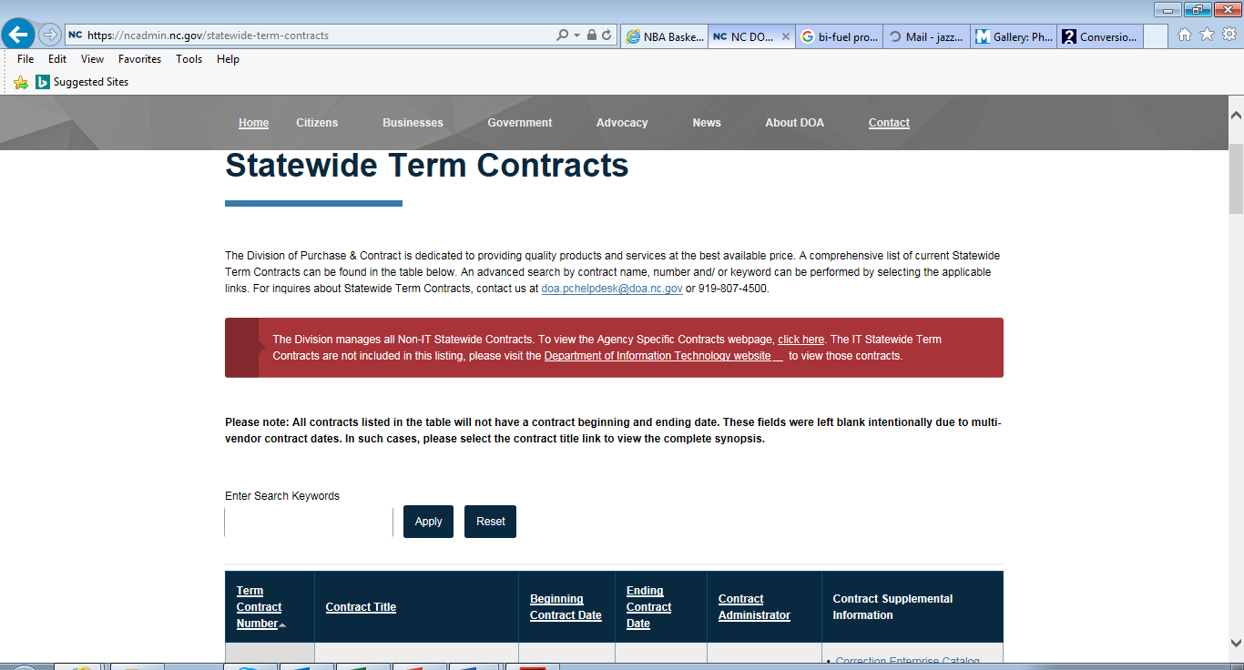
2020 Grantee Training Workshop
Procurement
  NC Purchasing & Contract Search
  https://ncadmin.nc.gov/statewide-term-contracts
  ontr

Slide 8
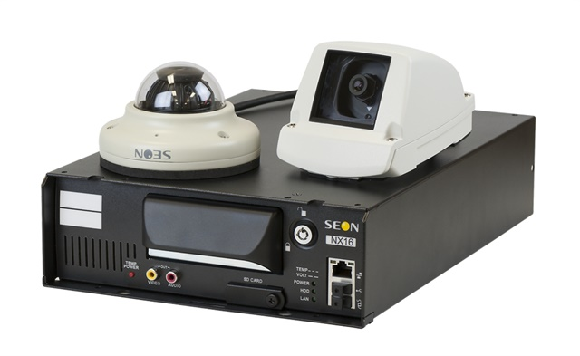
2020 Grantee Training Workshop
Procurement
  Camera System

Slide 9
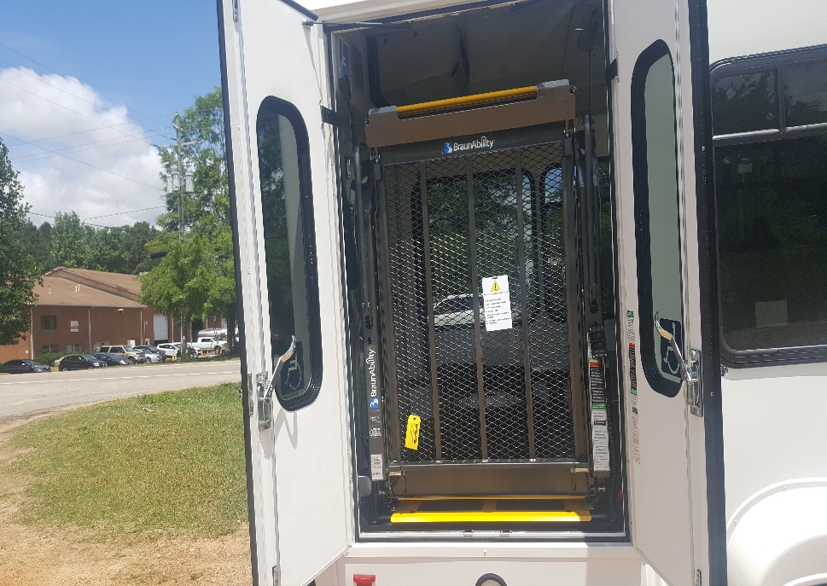
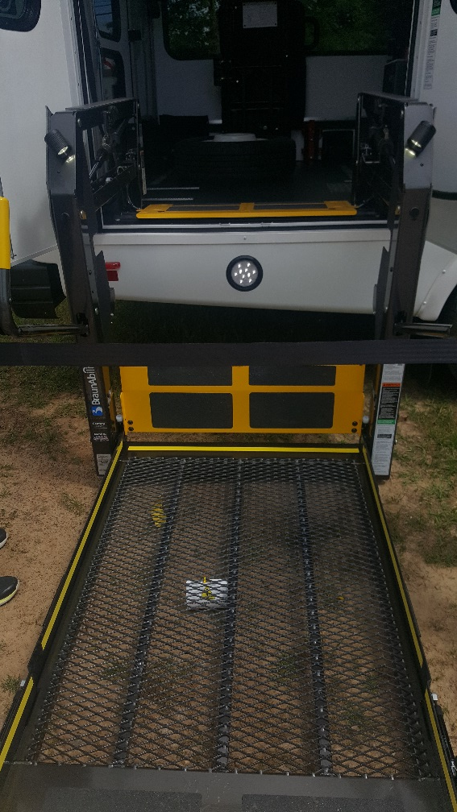
2020 Grantee Training Workshop
Procurement
  Lift

Slide 10
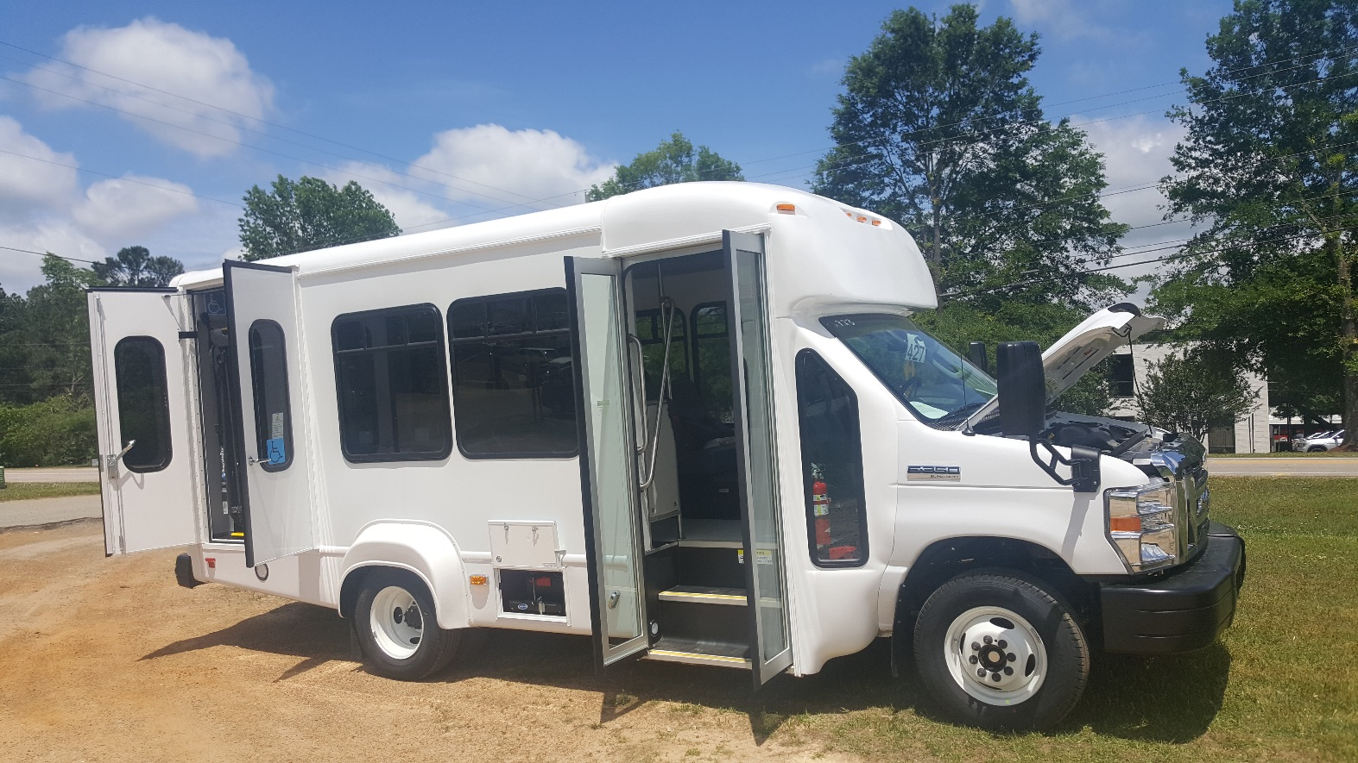
2020 Grantee Training Workshop
Procurement
  LTV

Slide 11
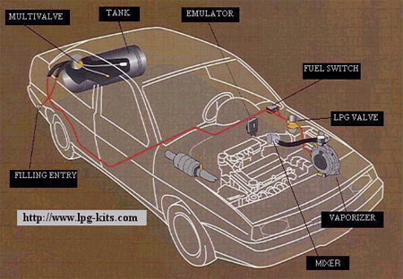
2020 Grantee Training Workshop
Procurement
  Bi-Fuel Propane Kit

Slide 12
2018 Grantee Training Workshop
Procurement
  Construction – Transit System

Slide 13
2020 Grantee Training Workshop
Procurement
  Construction – Transit System

Slide 14
2020 Grantee Training Workshop
Procurement
  Construction – Transit System

Slide 15
2020Grantee Training Workshop
Procurement
Local Procurement
  Effective with new Super Circular (12/26/14), all subrecipients of the state follow state’s procurement policies and procedures.
    Provide full & open competition on all procurements > $10,000.;
    Include all applicable FTA clauses > $10,000., including Buy America, Debarment and Suspension, and Restrictions on Lobbying;

Slide 16
2020Grantee Training Workshop
Procurement
FTA Contract Clauses……
  Operation Management
  Professional/Architectural/Engineering
  Radio Equipment
  Technology Goods & Services
  Rolling Stock
  Construction
  Materials & Equipment

Slide 17
2020 Grantee Training Workshop
Procurement
FTA Clause Requirements continued…..
FEDERAL AND STATE REQUIREMENTS
AND SPECIAL CONDITIONS
For CONSTRUCTION
2. Federal Changes
Contractor shall at all times comply with all applicable Federal Transit Administration (FTA) regulations, policies, procedures and directives, including without limitation those listed directly or by reference in the Master Agreement between Purchaser and FTA, as they may be amended or promulgated from time to time during the term of this contract. Contractor's failure to so comply shall constitute a material breach of this contract.

Slide 18
2020 Grantee Training Workshop
Procurement
Local Procurement (cont.)
    Comply with the N.C.G.S. 143 Article 3D, Procurement of Architectural, Engineering, and Surveying Services (Brooks Act)
    Comply with the five-year limitation on purchases of rolling stock or replacement parts; and
    Award only to responsible contractors/vendors.

Slide 19
2020 Grantee Training Workshop
Procurement
Construction Projects
All construction related activities over $10,000. shall require pre-award review and approval by the division before completing the task. The following activities are included, but not limited to, the PTD’s pre-award review and approval:
  Planning and Needs Assessment study
  Appraisal of property
  Environmental assessment
  Land acquisition
  Architect or Professional Engineer selection
  Design phases
  Project Management Oversight
  New construction, renovation, or improvements bids and contract award

Slide 20
2020 Grantee Training Workshop
Procurement
Order Form Process (LTV’s & RR Vans) Available on procurement website & are sent out each FY to eligible transit systems
Vehicle Delivery (24-hour inspection required by transit system upon delivery) Inspection forms available on procurement website
Procurement Reimbursement requirements
- Procurement Checklist
Informal
$10,000 - $29,999 Price Quote Checklist
$30,000 - $89,999 (Equipment/Supplies) Informal Bids
$30,000 - $150,000 (Construction Federal only) Informal Bids
$30,000 - $499,999 (Construction State Funds only) Informal Bids

Slide 21
2020 Grantee Training Workshop
Procurement continued….
Formal (Seal) Bids
$90,000 - (Equipment/Supplies) State & Federal funded
$500,000 – (Construction) State funded
$150,000 - $500,000 (Construction) Federal funded

Slide 22
2020 Grantee Training Workshop
Procurement continued….
Procurement History Form (Reflects how price was determined to be fair and reasonable) Must include the following:
- 3 quotes
- Project No.
- Project Period
- Approved Budget
- Explanation on how vendor was selected
- Attached quote documentation

Slide 23
2020 Grantee Training Workshop
Procurement Case Question # 1
Regional Transit Authority (RTA) has been approved for one standard 20’ LTV in their FY21 budget. They have been budgeted $27,000 under G571 in the 5311 Capital Grant and realize that the new LTV contract has been awarded for LTV’s by the State Purchase and Contract Division. The 2020 20’ LTV they are interested in was awarded to Interstate Sales in Charlotte, NC and they have proceeded to contact the fleet salesperson to get the options to add on to the base price. RTA’s Financial Manager is preparing to issue a Purchase Order to Interstate Bus in the amount of $25,500.
What other document is required to be submitted to Interstate Bus Sales?
When the vehicle is delivered to the transit system, what must be completed in the first 24 hours?
If there are issues with the vehicle and it is not acceptable, what must then occur?

Slide 24
2020 Grantee Training Workshop
Procurement
Disposition
  Disposition of Vehicles
    Disposition process starts when new replacement vehicle is delivered;
    The inspection/disposition form is completed for the vehicles and submitted to PTD;
    Vehicles that are replaced are to be removed from the fleet and disposed within 60 days;
      Mark D or R in AssetWorks Inventory
    Proceeds from the sale may be used as local match for the transportation program.
      All proceeds must be used for transportation needs.

Slide 25
2020 Grantee Training Workshop
Procurement
Disposition
  Casualty Loss of Vehicles
    When a vehicle accident/incident occurs, it must be entered in AssetWorks as soon as possible, no later than next business day;
      Drug & Alcohol testing results must be sent to Compliance Unit.
    A vehicle that is totaled, additional paperwork must be submitted to release title:
      Drug/Alcohol test – send to staff in Safety & Compliance.
      Police Report – send to the Procurement Specialist
      Insurance settlement letter – send to Procurement Officer.
      AssetWorks’ incident # - send to Procurement Specialist.

Slide 26
2020 Grantee Training Workshop
Procurement Case Question # 2
What is the function of both the Procurement Checklist and Procurement History Form?

Slide 27
2020 Grantee Training Workshop
Procurement Case Question # 3
ABC Transit System purchased a computer priced at $5.750 back in April 2019 and submits a request February 2020 for reimbursement to Finance which then rejects the invoice. What would be some of the reasons this invoice was rejected?

Slide 28


2020 Grantee Training Workshop
Questions and Answers

